Slide 1
LESSON 10

Slide 2
Overview
of
Previous Lesson(s)

Slide 3
Over View
Symbol tables are data structures that are used by compilers to hold information about source-program constructs.
Information is put into the symbol table when the declaration of an identifier is analyzed.
Entries in the symbol table contain information about an identifier such as its lexeme, its type, its position in storage, and any other relevant information.
The information is collected incrementally.

Slide 4
Over View..
A token is a pair consisting of a token name and an optional attribute value.
A pattern is a description of the form that the lexemes of a token may take.
In the case of a keyword as a token, the pattern is just the sequence of characters that form the keyword.
A lexeme is a sequence of characters in the source program that matches the pattern for a token and is identified by the lexical analyzer as an instance of that token.

Slide 5
Over View…
Some definitions:
Def: An alphabet is a finite set of symbols.
Ex: {0,1}, presumably φ (uninteresting), ascii, unicode, ebcdic
Def: A string over an alphabet is a finite sequence of symbols from that alphabet. Strings are often called words or sentences.
Ex: Strings over {0,1}: ε, 0, 1, 111010.

Slide 6
Over View…
Def: A language over an alphabet is a countable set of strings over the alphabet.
Ex: All grammatical English sentences with five, eight, or twelve words is a language over ascii.
Def: The concatenation of strings s and t is the string formed by appending the string t to s. It is written st.
Def: The length of a string is the number of symbols (counting duplicates) in the string.
Ex: The length of vciit, written |vciit|, is 5.

Slide 7
Over View…
Def: A prefix of string S is any string obtained by removing zero or more symbols from the end of s.
Ex: ban, banana, and ε are prefixes of banana.
Def: A suffix of string s is any string obtained by removing zero or more symbols from the beginning of s.
Ex: nana, banana, and ε are suffixes of banana.
Def: substring of s is obtained by deleting any prefix and any suffix from s.
Ex: banana, nan, and ε are substrings of banana.

Slide 8
Over View...
Operations on Languages:
L U D is the set of letters and digits, each of which strings is either one letter or one digit.
LD is the set of 520 strings of length two, each consisting of one letter followed by one digit.
L⁴ is the set of all 4-letter strings.
L * is the set of ail strings of letters, including ε, the empty string.
L(L U D)* is the set of all strings of letters and digits beginning with a letter.
D⁺ is the set of all strings of one or more digits.

Slide 9
Over View…
A regular expression is a sequence of characters that forms a search pattern, mainly for use in pattern matching with strings.
The idea is that the regular expressions over an alphabet consist of the alphabet, and expressions using union, concatenation, and *, but it takes more words to say it right.
Each regular expression r denotes a language L(r) , which is also defined recursively from the languages denoted by r's subexpressions.

Slide 10
Over View…
Ex. Let Σ = {a, b}
The regular expression a | b denotes the language {a, b} .
(a|b)(a|b) denotes {aa, ab, ba, bb} , the language of all strings of length two over the alphabet Σ .
a* denotes the language consisting of all strings of zero or more a's, that is, {ε , a, aa, aaa, ... }.

Slide 11
Over View…
If Σ is an alphabet of basic symbols, then a regular definition is a sequence of definitions of the form:
d₁ - > r₁
d₂ - > r₂
......
d_{n} - > r_{n}
Where the d's are unique and not in Σ and r_{i} is a regular expressions over Σ ∪ {d₁,...,d_{i-1}}.

Slide 12
TODAY’S LESSON

Slide 13
Contents
Recognition of Tokens
Transition Diagrams
Recognition of Reserved Words and Identifiers
Recognizing Whitespace
Recognizing Numbers
Finite Automata
NFA
Transition Tables

Slide 14
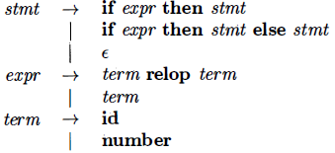
Recognition of Tokens
Now we see how to build a piece of code that examines the input string and finds a prefix that is a lexeme matching one of the patterns.
Our current goal is to perform the lexical analysis needed for the following grammar.
Recall that the terminals are the tokens & the nonterminals produce terminals.

Slide 15
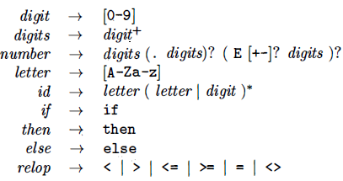
Recognition of Tokens..
A regular definition for the terminals is

Slide 16
Recognition of Tokens…
We also want the lexer to remove whitespace so we define a new token
ws → ( blank | tab | newline ) +
where blank, tab, and newline are symbols used to represent the corresponding ascii characters.
If the lexer recognizes the token ws, it does not return it to the parser but instead goes on, to recognize the next token, which is then returned.

Slide 17
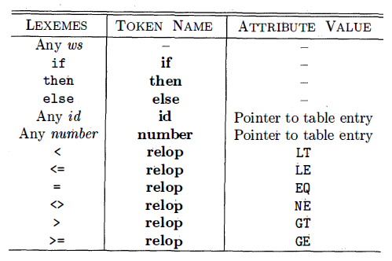
Recognition of Tokens..
Our goal for the lexical analyzer is summarized below:

Slide 18
Transition Diagram
As an intermediate step in the construction of a lexical analyzer, we first convert patterns into stylized flowcharts, called "transition diagrams”.
Conversion of RE patterns to Transition Diagram.
Transition diagrams have a collection of nodes or circles, called states
Each state represents a condition that could occur during the process of scanning the input looking for a lexeme that matches one of several patterns.

Slide 19
Transition Diagram..
Edges are directed from one state of the transition diagram to another.
Each edge is labeled by a symbol or set of symbols.
Some important conventions:
The double circles represent accepting or final states at which point a lexeme has been found. There is often an action to be done (e.g., returning the token), which is written to the right of the double circle.
If we have moved one (or more) characters too far in finding the token, one (or more) stars are drawn.
An imaginary start state exists and has an arrow coming from it to indicate where to begin the process.

Slide 20
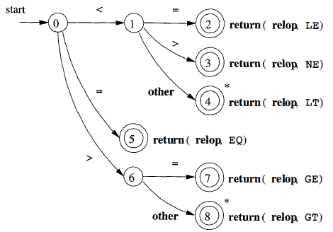
Transition Diagram…
A transition diagram that recognizes the lexemes matching the token relop.

Slide 21
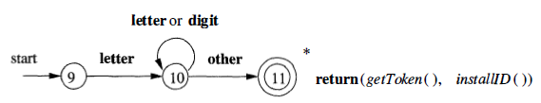
Recognition of Reserved Words and Identifiers
Recognizing keywords and identifiers presents a problem.
The transition diagram below corresponds to the regular definition given previously.

Slide 22
Recognition of Reserved Words and Identifiers
Two questions arises:
How do we distinguish between identifiers and keywords such as then, which also match the pattern in the transition diagram?
What is (gettoken(), installID())?
We will use the method, i.e having the keywords installed into the identifier table prior to any invocation of the lexer.
The table entry will indicate that the entry is a keyword.

Slide 23
Recognition of Reserved Words and Identifiers..
installID() checks if the lexeme is already in the table. If it is not present, the lexeme is installed as an id token. In either case a pointer to the entry is returned.
gettoken() examines the lexeme and returns the token name, either id or a name corresponding to a reserved keyword.
So far we have transition diagrams for identifiers (this diagram also handles keywords) and the relational operators.
What remains are whitespace, and numbers.

Slide 24
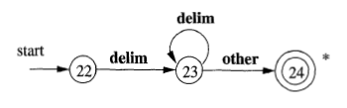
Recognizing Whitespace
Recognizing Whitespace
The delim in the diagram represents any of the whitespace characters, say space, tab, and newline.
The final star is there because we needed to find a non-whitespace character in order to know when the whitespace ends and this character begins the next token.
There is no action performed at the accepting state.

Slide 25
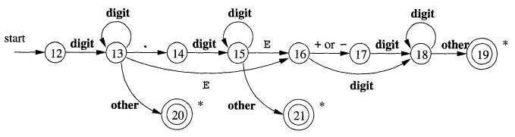
Recognizing Numbers
The transition diagram for token number

Slide 26
Finite Automata
Finite automata are like the graphs in transition diagrams but they simply decide if an input string is in the language (generated by our regular expression).
Finite automata are recognizers, they simply say "yes" or "no" about each possible input string.
There are two types of Finite automata:
Nondeterministic finite automata (NFA) have no restrictions on the labels of their edges. A symbol can label several edges out of the same state, and ε, the empty string, is a possible label.

Slide 27
Finite Automata..
Deterministic finite automata (DFA) have exactly one edge, for each state, and for each symbol of its input alphabet with that symbol leaving that state.
So if you know the next symbol and the current state, the next state is determined. That is, the execution is deterministic, hence the name.
Both deterministic and nondeterministic finite automata are capable of recognizing the same languages.

Slide 28
N - Finite Automata
A nondeterministic finite automaton (NFA) consists of:
1. A finite set of states S.
2. A set of input symbols Σ, the input alphabet. We assume that ε, which stands for the empty string, is never a member of Σ.
3. A transition function that gives, for each state, and for each symbol in Σ U {ε} a set of next states.
4. A state S₀ from S that is distinguished as the start state (or initial state)
5. A set of states F, a subset of S, that is distinguished as the accepting states (or final states).

Slide 29
N - Finite Automata..
An NFA is basically a flow chart like the transition diagrams we have already seen.
Indeed an NFA can be represented by a transition graph whose nodes are states and whose edges are labeled with elements of Σ ∪ ε.
The differences between a transition graph and previous transition diagrams are:
Possibly multiple edges with the same label leaving a single state.
An edge may be labeled with ε.

Slide 30
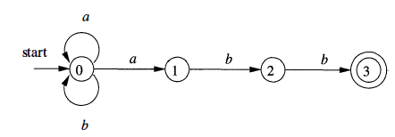
N - Finite Automata...
Ex: The transition graph for an NFA recognizing the language of regular expression (a | b) * abb
This ex, describes all strings of a's and b's ending in the particular string abb.

Slide 31
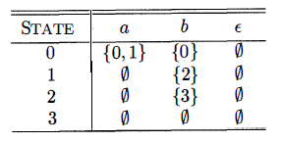
Transition Tables
Transition Table is an equivalent way to represent an NFA, in which, for each state s and input symbol x (and ε), the set of successor states x leads to from s.
The empty set φ is used when there is no edge labeled x emanating from s.
Transition Table for (a | b) * abb

Slide 32
Thank You

